Slide 1
SECURE DATA HIDING IN IMAGES USING STEGANOGRAPHY
CAPSTONE PROJECT
Presented By: SATYAM GUPTA
Student Name : SATYAM GUPTA
College Name & Department : SANSKAR COLLEGE OF ENGINEERING AND TECHNOLOGY (AKTU)

Slide 2
OUTLINE
Problem Statement
Technology used
Wow factor
End users
Result
Conclusion
Git-hub Link
Future scope

Slide 3
Problem Statement
Steganography is the practice of hiding information within a non-secret medium like text, images, or audio to avoid detection. The key challenges include making sure the hidden data stays undetectable, preserving the integrity of the carrier medium, and safeguarding the concealed information from unauthorized access. Tackling these challenges is crucial for effective and secure information concealment.

Slide 4
Technology used
System Requirement : Windows11 (Gen 11th)
RAM & Stroage : 8GB & 256 GB (SSD)
IDLE : VSCode or PYcharm
Language : Python(3.9 upto latest version support)
Libraries : pycryptodome ,AES , encryption
Graphics : Intel IRIS

Slide 5
Wow factors
What makes this project stand out from other project(Unique features)
Concealment of Information
Security Measures
Diverse Applications
Robustness Against Detection
High Capacity Embedding

Slide 6
End users
Cybersecurity Professionals
Malware Developers
General Public
Researchers and Academics
Digital Forensics Experts
Intelligence Agencies

Slide 7
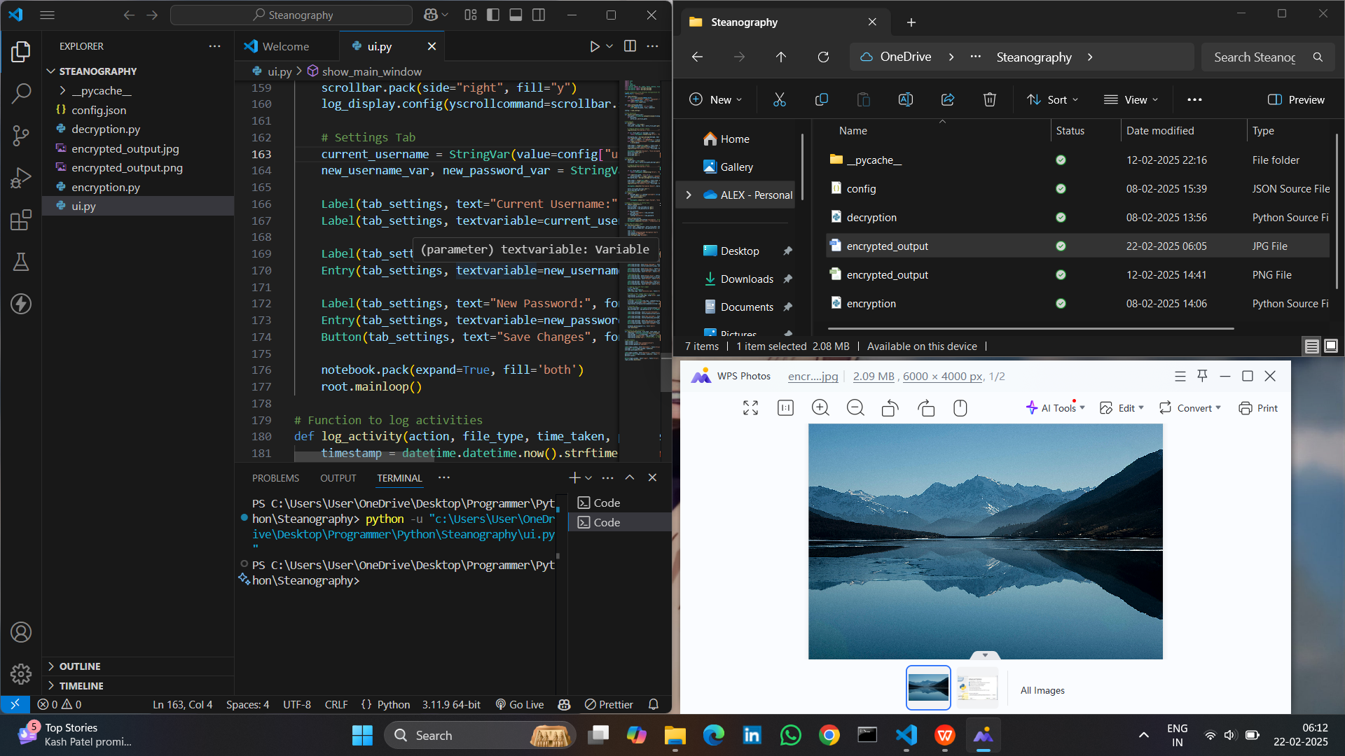
Results

Slide 8
Conclusion
Conclude your project concerning your problem statement.
This project demonstrates the feasibility of implementing steganography using Python, offering a practical tool for secure communication. The use of Tkinter and Pillow libraries facilitated the development of an effective and user-friendly application. Future enhancements could include incorporating encryption techniques to further secure the hidden messages and expanding the application to support various media types beyond images.
Applications :
Graphical User Interface (GUI)
Image Processing
Encoding and Decoding Functions

Slide 9
GitHub Link
https://github.com/Satyam77Gupa/Steanography.git

Slide 10
Future scope(optional)
Steganography in Streaming Media
Advancements in Image and Video Steganography
Applications in Emerging Technologies
Integration with Artificial Intelligence (AI)
Enhanced Security Measures

Slide 11
THANK YOU

